Slide 1
Modified K-Means for Improving the Efficiency and Accuracy

Slide 2
ABSTRACT
Cluster Analysis is one of the Data Mining tasks that aims to discover patterns and knowledge through different algorithmic techniques such as K-Means.
K-Means over distributed big data stores has given rise to serious privacy issues.
Accordingly, many proposed works attempted to tackle this concern using cryptographic protocols.
However, these cryptographic solutions introduced performance degradation issues in analysis tasks which does not meet big data properties.
In this project, we propose a novel privacy preserving k-means algorithm based on a simple yet secure and efficient multiparty additive scheme .
We designed our solution for horizontally partitioned data.

Slide 3
Introduction
Big data analytics is performed through several advanced data mining techniques such as clustering.
This analysis task consists of discovering patterns from a set of data objects, then affecting each object to the closest pattern.
Working on automating such a task has produced several methods known as unsupervised learning such as K-Means algorithm.
Indeed, big data clustering is now a keystone requirement for several areas of life like healthcare, social science, business and marketing.

Slide 4
LITERATURE SURVEY
A Comparative Study of Efficient Initialization Methods for the K-Means Clustering Algorithm
K-Means is undoubtedly the most widely used partition clustering algorithm.
Unfortunately, due to its gradient descent nature, this algorithm is highly sensitive to the initial placement of the cluster centers. Numerous initialization methods have been proposed to address this problem.
First, we present an overview of these methods with an emphasis on their computational efficiency.
We then compare eight commonly used linear time complexity initialization methods on a large and diverse collection of data sets using various performance criteria.
Finally, we analyze the experimental results using non-parametric statistical tests and provide recommendations for practitioners.

Slide 5
Some methods for Classification and Analysis of Multivariate Observations
The K-Means procedure is easily programmed and is computationally economical, so that it is feasible to process very large samples on a digital computer.
Possible applications include methods for similarity grouping, non-linear prediction, approximating multivariate distributions, and non-parametric tests for independence among several variables.
In addition to suggesting practical classification methods, the study of K-Means has proved to be theoretically interesting.
The K-Means concept represents a generalization of the ordinary sample mean, and one is naturally led to study the pertinent asymptotic behaviour, the object being to establish some sort of law of large numbers for the
K-Means.

Slide 6
Refining Initial Points for K-Means Clustering
Practical approaches to clustering use an iterative procedure (e.g. K-Means, EM) which converges to one of numerous local minima.
It is known that these iterative techniques are especially sensitive to initial starting conditions.
We present a procedure for computing a refined starting condition from a given initial one that is based on an efficient technique for estimating the modes of a distribution.
The refined initial starting condition allows the iterative algorithm to converge to a “better” local minimum.
The procedure is applicable to a wide class of clustering algorithms for both discrete and continuous data.

Slide 7
Optimised K-Means
K-Means remains one of the most popular data processing algorithms.
A proper initialization of K-Means is crucial for obtaining a good final solution.
The recently proposed optimised initialization algorithm achieves this, obtaining an initial set of centers that is provably close to the optimum solution.
A major downside of this implementation is its inherent sequential nature, which limits its applicability to massive data: one must make k passes over the data to find a good initial set of centers.
In this work, we show how to drastically reduce the number of passes needed to obtain, in parallel, a good initialization.
This is unlike prevailing efforts on parallelizing K-Means that have mostly focused on the post-initialization phases of K-Means.

Slide 8
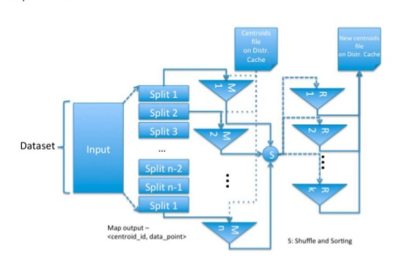
ARCHITECTURE DIAGRAM

Slide 9
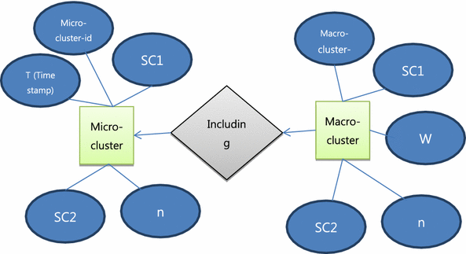
ER DIAGRAM

Slide 10
CHALLENGES INVOLVED
Handling Empty Clusters
This occurs when no points are assigned to a centroid during the assignment step, the re-calculation step does not get rid of this cluster, and it also does not re-calculate the centroid value because no points are being used and so essentially we will have an output with k-1 cluster.

Slide 11


